Slide 1

IntelligenceEDGE Generative AI
Oct, 2024

Slide 2
Generative AI requirements
A conversational chatbot agent on CI data and any additional clinical trial/library documentation added
The feature will be available within all dashboards and to all users within a dashboard
The chatbot will need to be able to filter, analyze, and summarize the data within the dashboard
The agent will also need to retrieve additional context within the realm of CI dashboard documents on filtered data points if needed
The agent should perform a RAG only on data available within the context of a dashboard
Built in filter. Product name and timeline?
Data within a dashboard would be a mix of structured relational data and unstructured documents
The chatbot will need to store the context of the entire conversation in its state.
The chatbot will need to keep a history of conversation by user (not MVP)

Slide 3
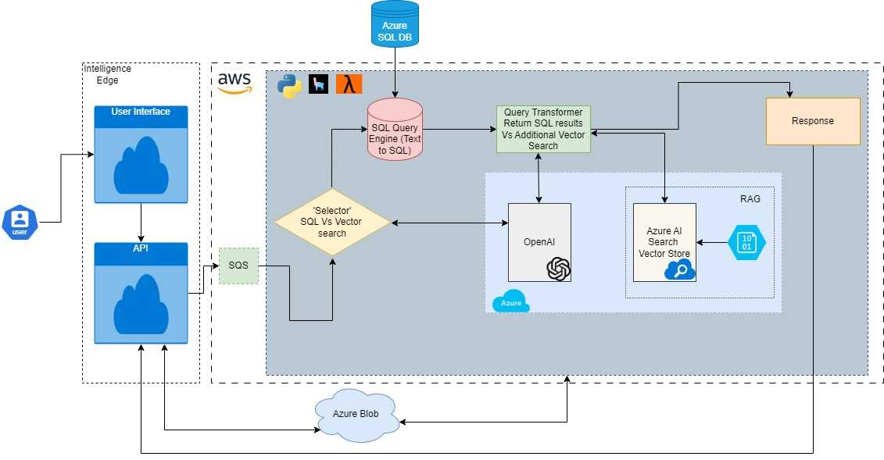
Generative AI Architecture (Proposed)
* LLM used will be OpenAI GPT 4o

Slide 4
Azure AI Search + Azure Open AI
Azure AI Search is a fully managed search-as-a-service solution that provides powerful and flexible search capabilities for building applications.
Azure AI search provides hybrid (full text + vector) with semantic re-ranking capabilities to provide more contextually relevant results using advanced machine learning models.
Azure AI search high availability and scalability with Azure’s infrastructure, allowing for seamless scaling based on demand.
Azure AI search seamlessly integrates with other Azure services like, Azure SQL Database, Azure Blob Storage, and more, enabling comprehensive AI solutions.
Azure Open AI leverages Azure’s cloud infrastructure to ensure scalability, reliability, and performance, handling high loads and large-scale applications.
Azure Open AI benefits from Azure’s robust security measures, including data encryption, compliance certifications (e.g., GDPR, HIPAA), and enterprise-grade security features.
Azure Open AI provides access to OpenAI’s GPT models, including GPT-3.5 and GPT-4, allowing for advanced natural language processing (NLP) capabilities.

Slide 5
Llamaindex
Open-source Python/TS framework with strong and growing community with comprehensive documentation, making it easily accessible for developers.
Abstracts much of the complexity involved in working with large language models, allowing developers to focus on building their applications.
Robust data ingestion, indexing and retrieval
Can handle large volumes of data and scale horizontally. This makes it suitable for applications requiring the processing of extensive datasets and handling high query loads.
Provides OOB functionality for text2SQL style queries.
Provides OOB tools to handle both tabular search and RAG on unstructured data based in tabular search results.
Supports almost all LLMs including local LLMs including GPT-4o provisioned via Azure Open AI.
Supports Azure AI search as vector store along with many other vector stores like Chroma, Weaviate, Pinecone.

Slide 6
Fill in left to right, top to bottom

